Slide 1
Timesaver
Templates
Cover Image by: http://www.freepik.com

Slide 2
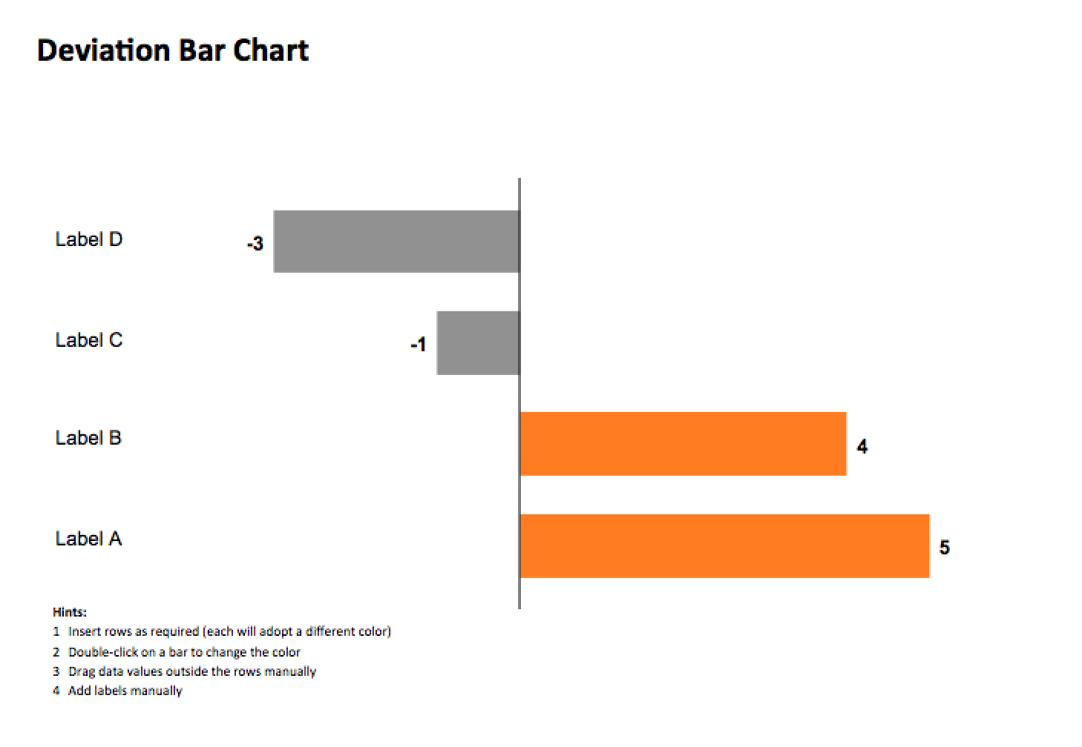
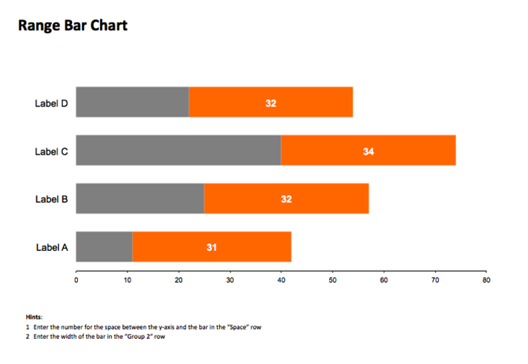
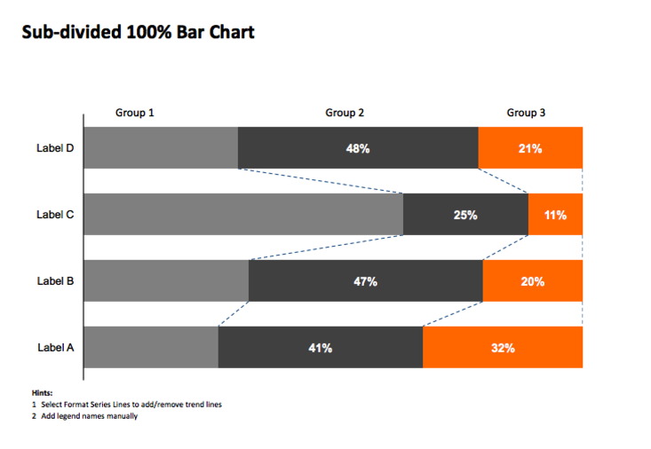
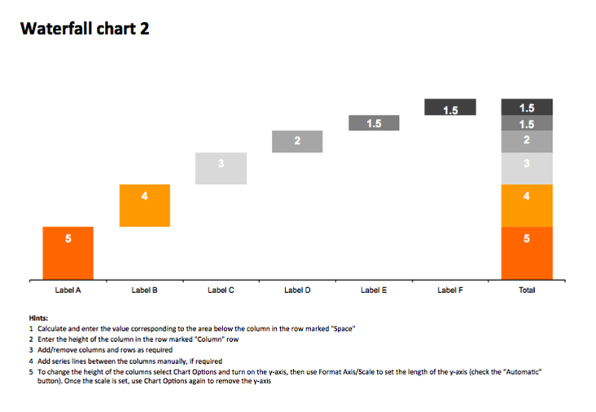
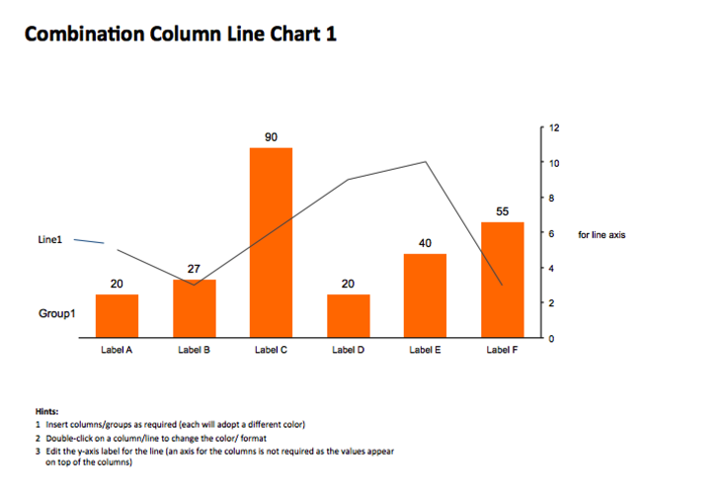
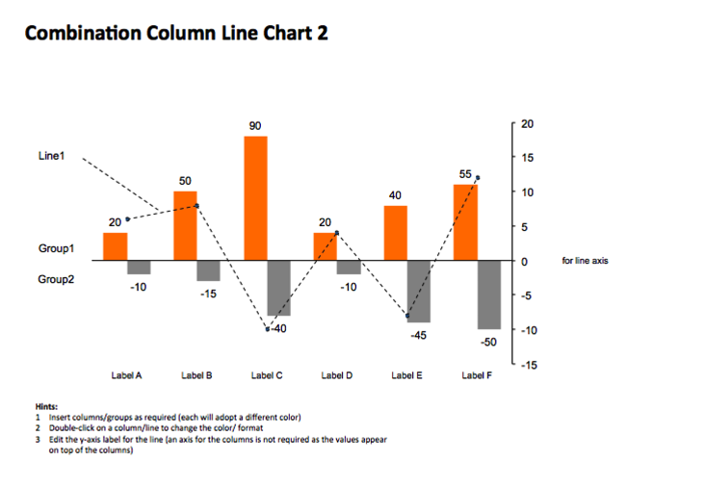
BAR CHARTS

Slide 3
Deviation Bar Chart
Hints:
1 Insert rows as required (each will adopt a different color)
2 Double-click on a bar to change the color
3 Drag data values outside the rows manually
4 Add labels manually

Slide 4
Range Bar Chart
Hints:
1 Enter the number for the space between the y-axis and the bar in the “Space“ row
2 Enter the width of the bar in the “Group 2“ row

Slide 5
Sliding Bar Chart
Hints:
1 Insert rows as required (each will adopt a different color)
2 Double-click on a bar to change the color
3 Drag data values outside the columns manually
4 Add labels manually
5 To change the width of the rows select Chart Options and turn on the x-axis, then use Format Axis/Scale to set the length of the x-axis. Once the scale is set, use Chart Options again to remove the x-axis

Slide 6
Sub-divided Bar Chart
Hints:
1 Calculate the total and enter it in the "Sum" row (which is in a transparent bar)
2 Left align the total value (which is in a transparent bar)
3 Add the legend names manually
4 To change the width of the rows select Chart Options and turn on the x-axis, then use Format Axis/Scale to set the length of the x-axis. Once the scale is set, use Chart Options again to remove the x-axis

Slide 7
Sub-divided 100% Bar Chart
Hints:
1 Select Format Series Lines to add/remove trend lines
2 Add legend names manually

Slide 8
Waterfall chart 1
Hints:
1 Calculate and enter the value corresponding to the area below the column in the row marked "Space"
2 Enter the height of the column in the row marked "Column" row
3 Add/remove columns and rows as required
4 Add series lines between the columns manually, if required
5 To change the height of the columns select Chart Options and turn on the y-axis, then use Format Axis/Scale to set the length of the y-axis (check the “Automatic” button). Once the scale is set, use Chart Options again to remove the y-axis

Slide 9
Waterfall chart 2
Hints:
1 Calculate and enter the value corresponding to the area below the column in the row marked "Space"
2 Enter the height of the column in the row marked "Column" row
3 Add/remove columns and rows as required
4 Add series lines between the columns manually, if required
5 To change the height of the columns select Chart Options and turn on the y-axis, then use Format Axis/Scale to set the length of the y-axis (check the “Automatic” button). Once the scale is set, use Chart Options again to remove the y-axis

Slide 10
Sub-divided 100% Column Chart
Hints:
1 Select Format Series Lines to add/remove trend lines
2 Edit Group names manually

Slide 11
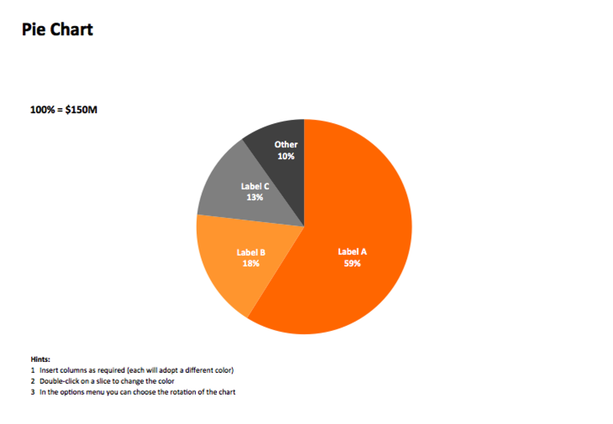
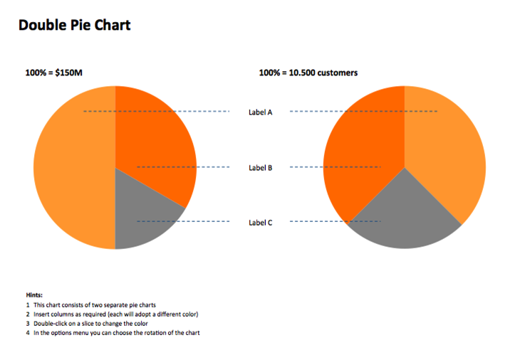
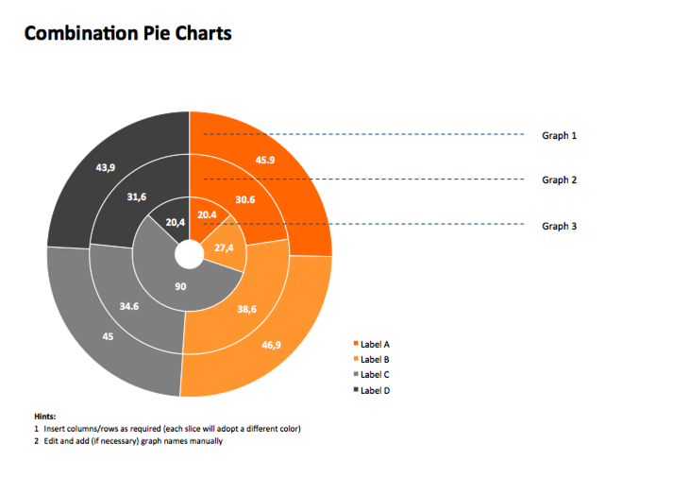
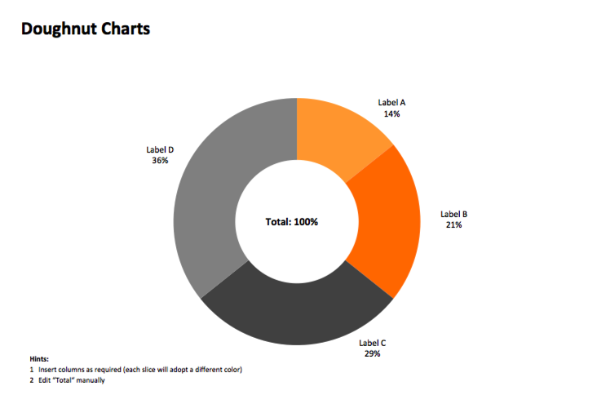
PIE CHARTS

Slide 12
Pie Chart
100% = $150M
Hints:
1 Insert columns as required (each will adopt a different color)
2 Double-click on a slice to change the color
3 In the options menu you can choose the rotation of the chart

Slide 13
Double Pie Chart
100% = $150M
100% = 10.500 customers
Label A
Label B
Label C
Hints:
1 This chart consists of two separate pie charts
2 Insert columns as required (each will adopt a different color)
3 Double-click on a slice to change the color
4 In the options menu you can choose the rotation of the chart

Slide 14
Combination Pie and Column Chart
100% = $150M
Hints:
1 Insert columns to add slices in pie as required (each will adopt a different color)
Double-click on a slice to change the color
To insert segments in bar chart:
Double-click on chart, click on either bar segment
Right mouse -> Format Data Point…
Select Options tab, increase the number after “Second plot contains the last…”
Insert columns as required

Slide 15
Combination Pie Charts
Graph 1
Graph 2
Graph 3
Hints:
1 Insert columns/rows as required (each slice will adopt a different color)
2 Edit and add (if necessary) graph names manually

Slide 16
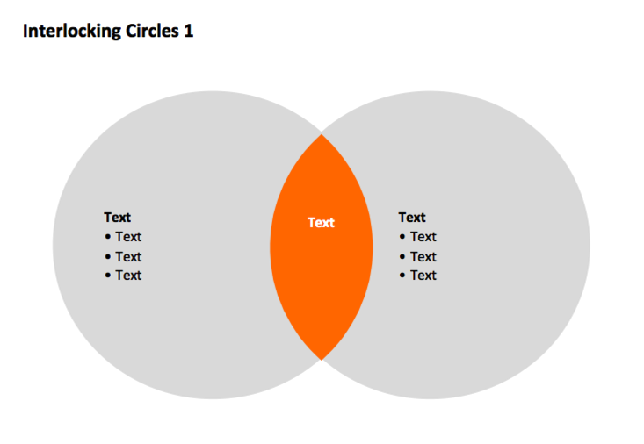
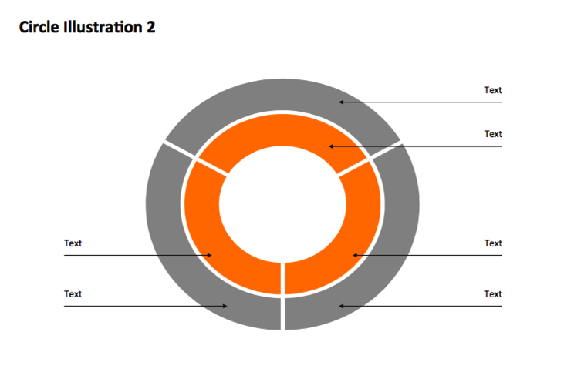
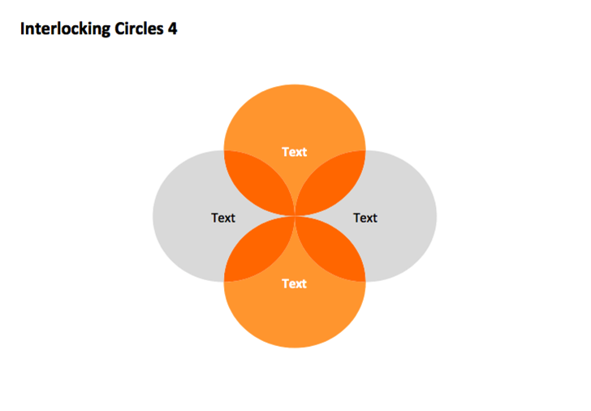
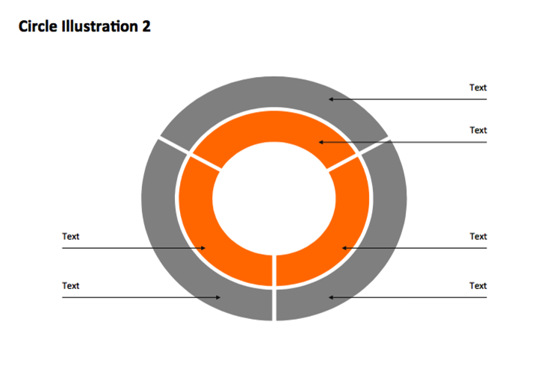
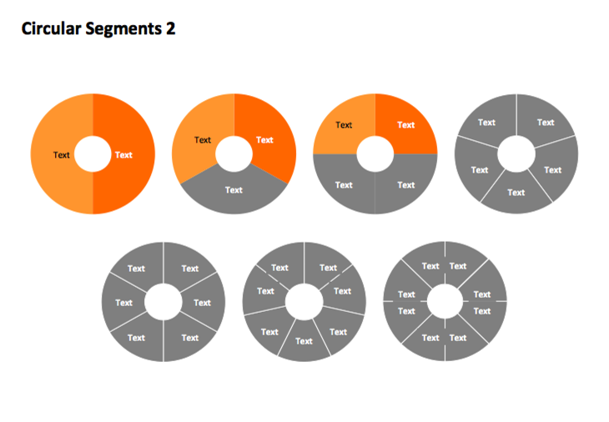
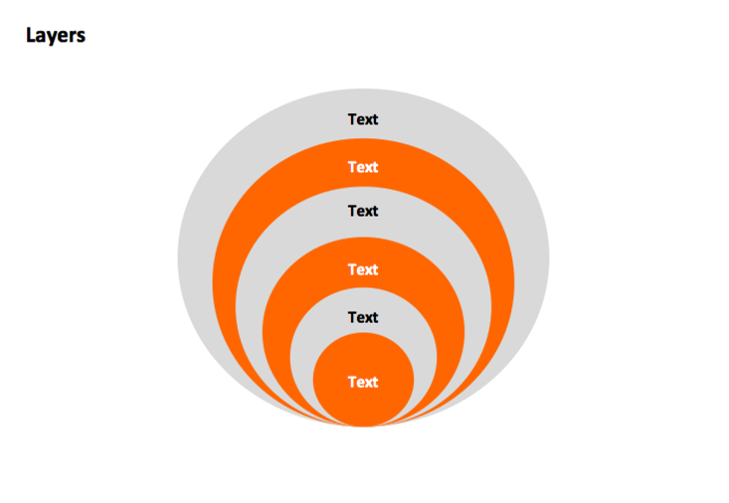
CIRCLES

Slide 17
Interlocking Circles 1
Text
Text
Text
Text
Text
Text
Text
Text
Text

Slide 18
Interlocking Circles 2
Text
Text
Text
Text
Text
Text
Text

Slide 19
Circular Segments 2
Text
Text
Text
Text
Text
Text
Text
Text
Text
Text
Text
Text
Text
Text
Text
Text
Text
Text
Text
Text
Text
Text
Text
Text
Text
Text
Text
Text
Text
Text
Text
Text
Text
Text
Text

Slide 20
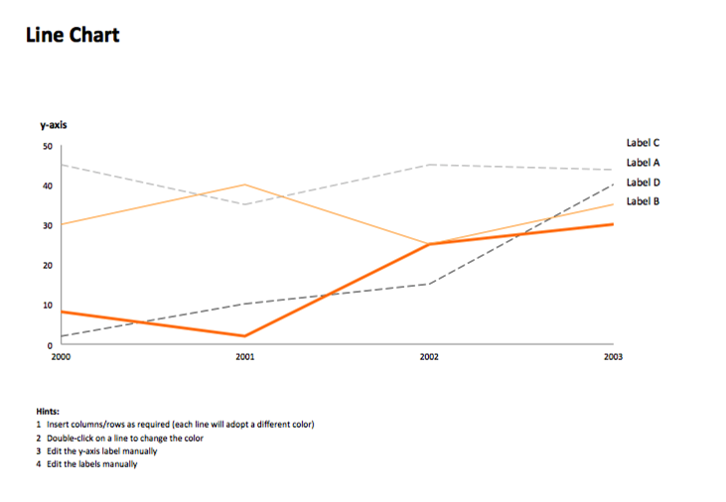
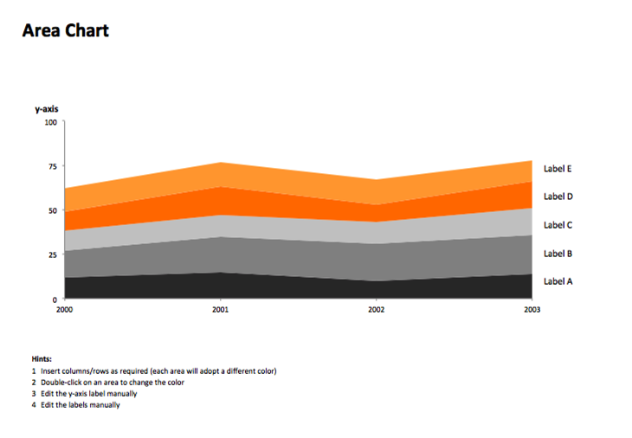
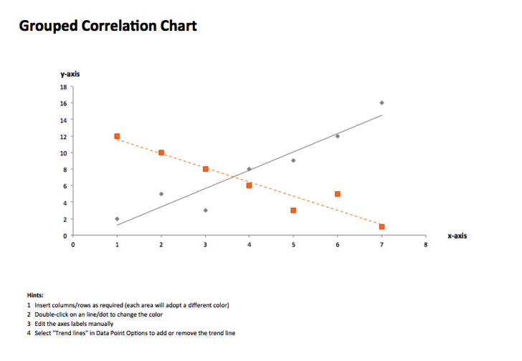
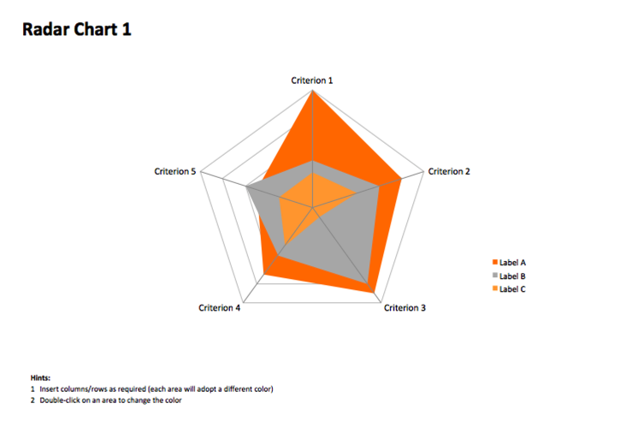
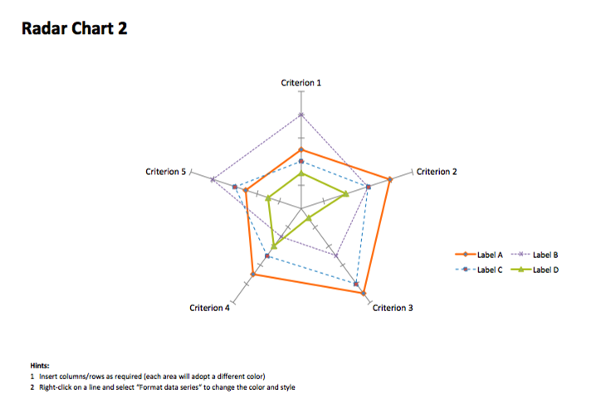
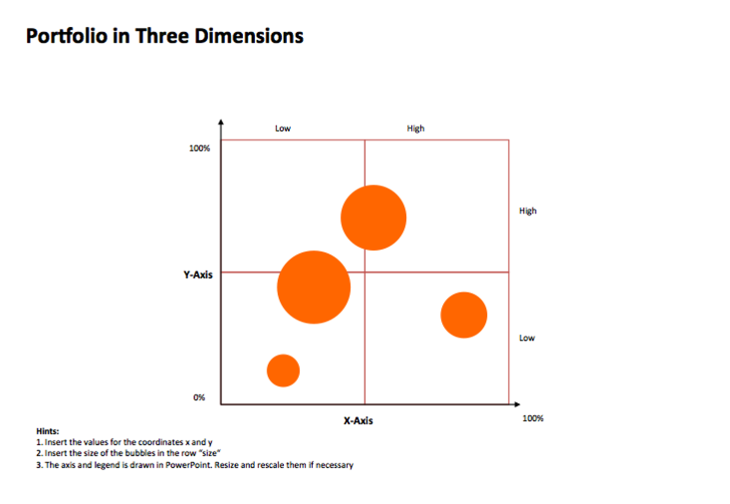
LINE AND OTHER CHARTS

Slide 21
Line Chart
Label C
Label A
Label D
Label B
Hints:
1 Insert columns/rows as required (each line will adopt a different color)
2 Double-click on a line to change the color
3 Edit the y-axis label manually
4 Edit the labels manually

Slide 22
Smooth Line Chart
Label C
Label A
Label D
Label B
Hints:
1 Insert columns/rows as required (each line will adopt a different color)
2 Double-click on a line to change the color
3 Edit the y-axis label manually
4 Edit the labels manually

Slide 23
Radar Chart 1
Hints:
1 Insert columns/rows as required (each area will adopt a different color)
2 Double-click on an area to change the color

Slide 24
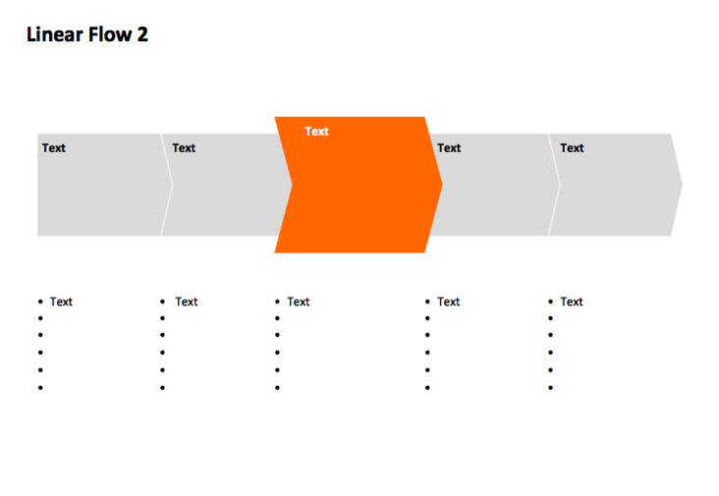
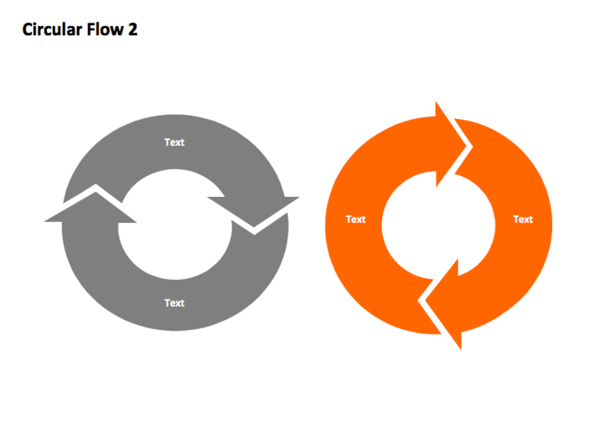
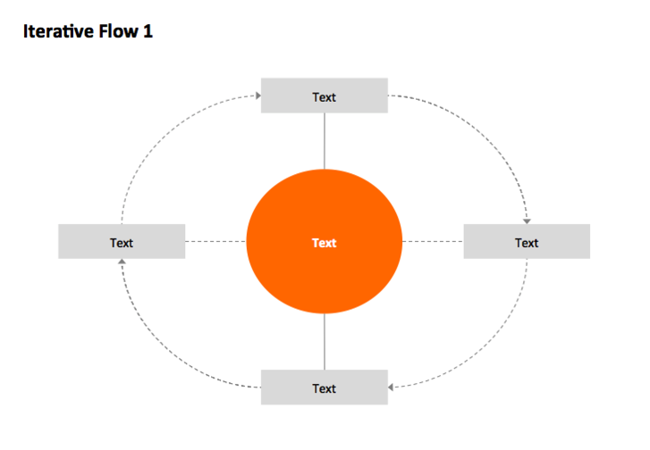
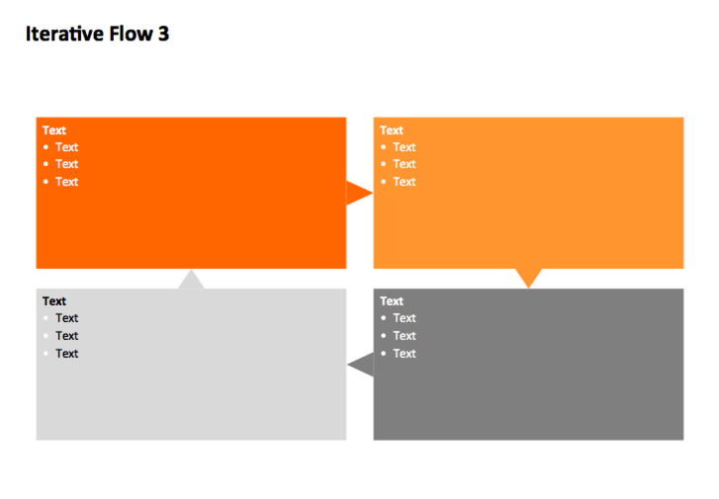
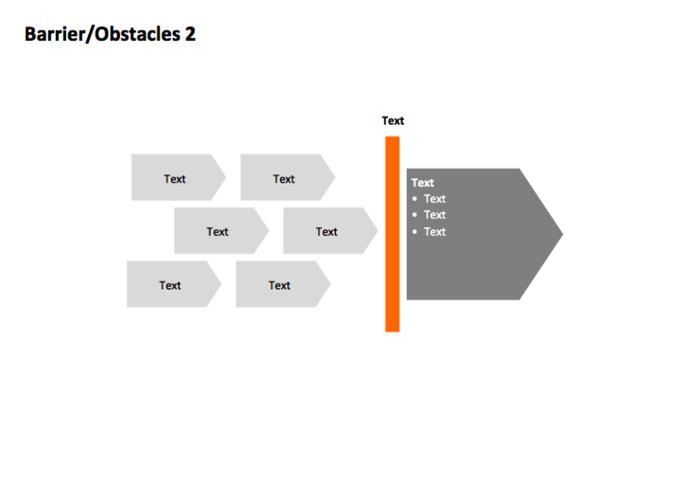
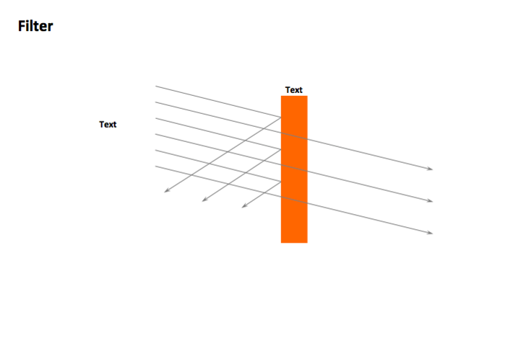
STRUCTURES

Slide 25
Horizontal Issue Tree
Text
Text
Text
Text
Text
Text
Text
Text
Text
Text
Text
Text
Text
Text
Text
Text
Text
Text
Text

Slide 26
Vertical Issue Tree
Text
Text
Text
Text
Text
Text
Text
Text
Text
Text
Text
Text
Text
Text
Text
Text
Text

Slide 27
Factors 1
Text
Text
Text
Text
Text
Text
Text
Text
Text
Text
Text
Text
Text

Slide 28
Consequences / Conclusion 1
Text
Text
Text
Text
Text
Text
Text
Text
Text
Text
Text
Text
Text
Text
Text

Slide 29
Consequences / Conclusion 2
Text
Text
Text
Text
Text
Text
Text
Text
Text
Text
Text
Text
Text
Text
Text
Text
Text
Text
Text
Text
Text
Text
Text
Text

Slide 30
Pillars
Text
Text
Text
Text
Text
Text
Text
Text
Text
Text
Text
Text
Text
Text
Text
Text
Text
Text

Slide 31
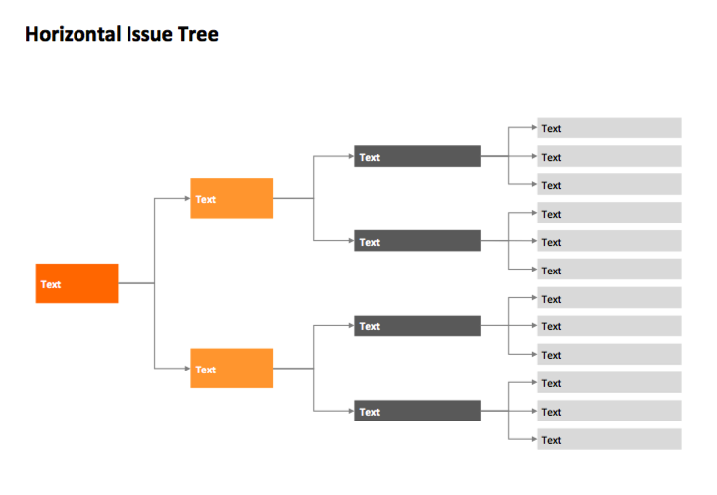
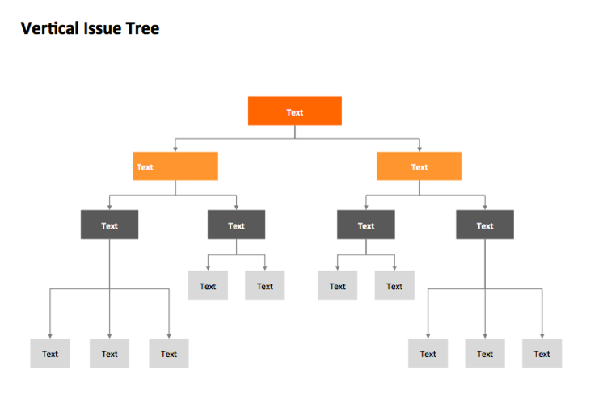
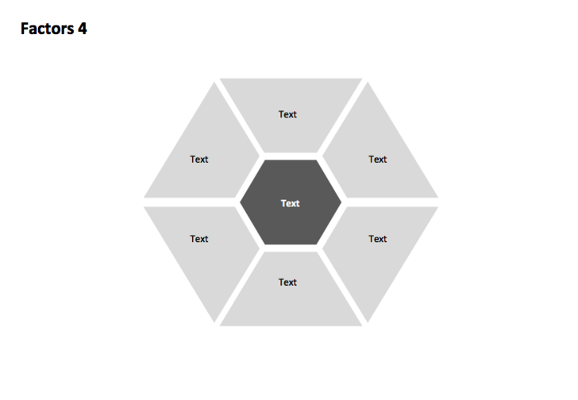
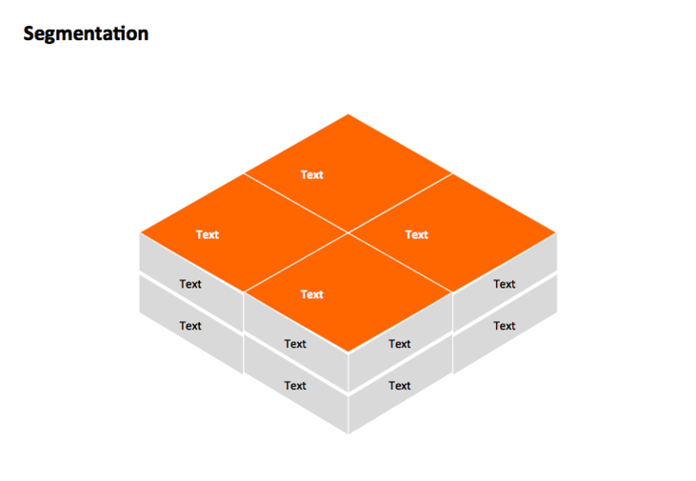
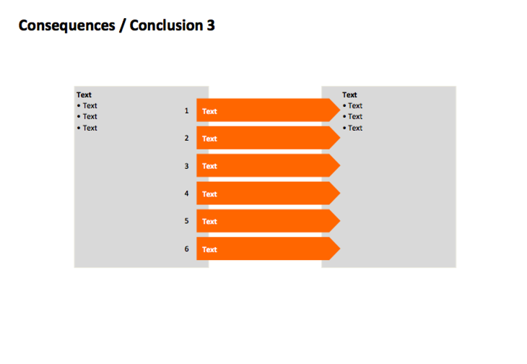
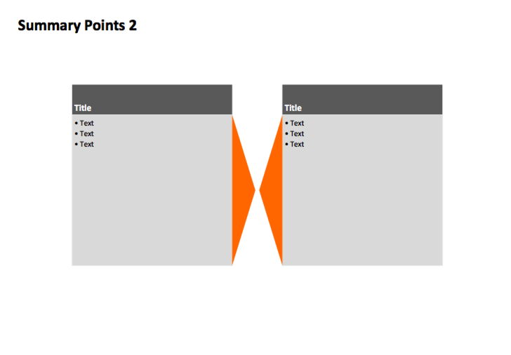
FLOWS

Slide 32
Linear Flow 1
Text
Text
Text
Text
Text
Text

Slide 33
Chevrons
Text
Text
Text

Slide 34
Steps-Descending
Text
Text
Text
Text
Text
Text

Slide 35
Steps-Ascending
Text
Text
Text
Text
Text
Text

Slide 36
Pipeline 1
Text
Text
Text
Text
Text

Slide 37
Pipeline 2
Text
Text
Text
Text
Text
Text

Slide 38
Iterative Flow 1
Text
Text
Text
Text
Text

Slide 39
Iterative Flow 2
Text
Text
Text
Text

